Slide 1
Mantid Current Development and Future Plans
Nicholas Draper ICNS 2013

Slide 2
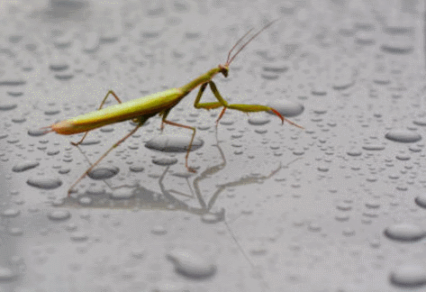
What Is Mantid
A framework that supports high-performance computing and visualisation of scientific data.
Manipulate and analyse Neutron and Muon data.
Neutron Scattering
Diffraction, spectroscopy, small angle, reflectometry
Muon Spectroscopy
Could be applied to other techniques
Open Source
Multiple Platforms
Windows, Linux, Mac

Slide 3

Project History
July 2007 Requirements & Design
April 2008 V 1.0 First instrument support
April 2010 Collaboration with SNS & HFIR
Jan 2012 V2.0
Scientist validated results. VATES integration
Nov 2012 V2.4 Live Data Reduction

Slide 4

Architectural Design - Overview
Instrument log files
Python
Command line & Scripting interface
Mantid Framework
RAW data files
API
Algorithms
Workspaces
MantidPlot Graphing and analysis
NEXUS data files
User Defined
User Defined
DAE direct access
Future Instrument specific UI
Future Instrument specific UI

Slide 5
Plug in extensions
Algorithm Dialogs Custom Interfaces Custom Menus
Python scripts & libraries
Workflow Algorithms
Algorithms
Unit Conversions
Fit Functions Cost Models Constraints Minimizer
Workspaces
Archive Searching LiveData Listeners Data Catalogs
GUI
Framework
Utility

Slide 6
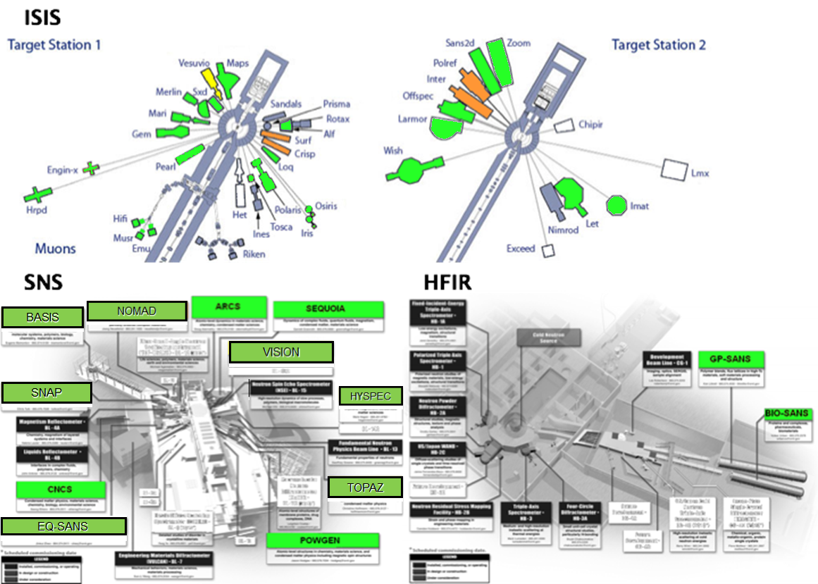
Members

Slide 7


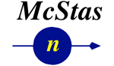



Contributors
NMI3 supported evaluation
IN4,5 & 6
D33
Focus
Lujan Nexus Load algorithm
Mibemol
Improving McStas – Mantid integration
LoadMcStas
TofTof

Slide 8

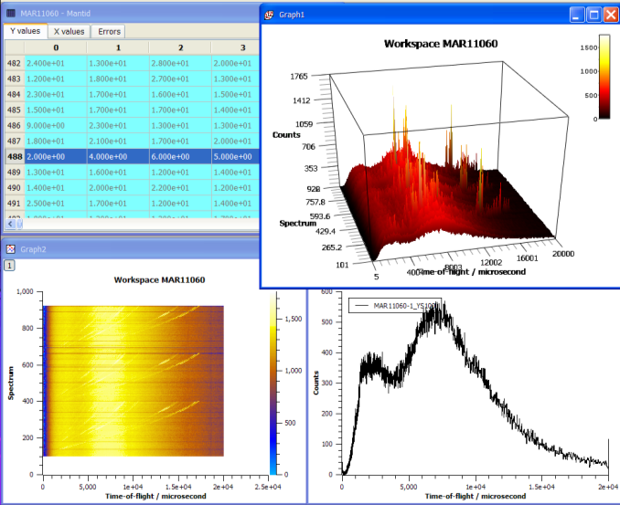
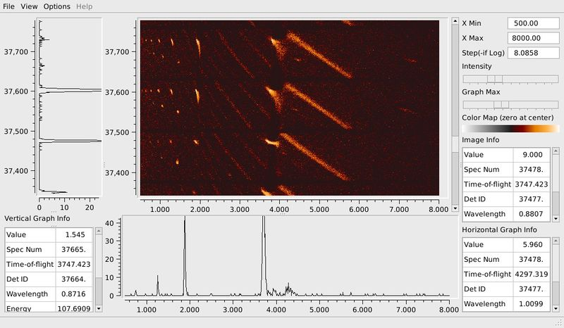
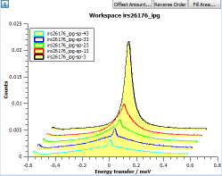
What can we do - Visualization

Slide 9
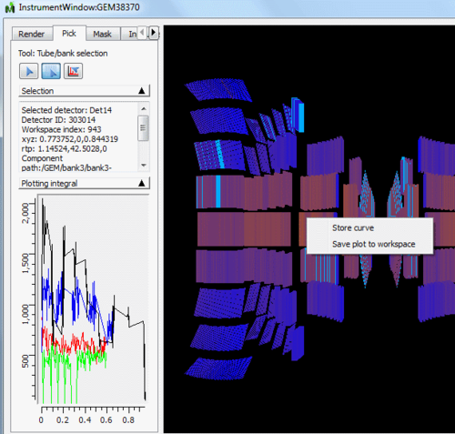
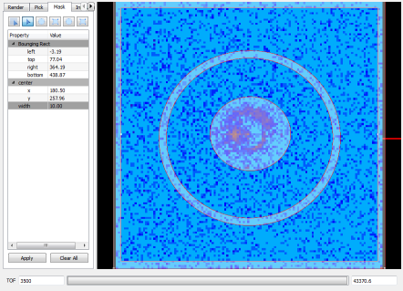
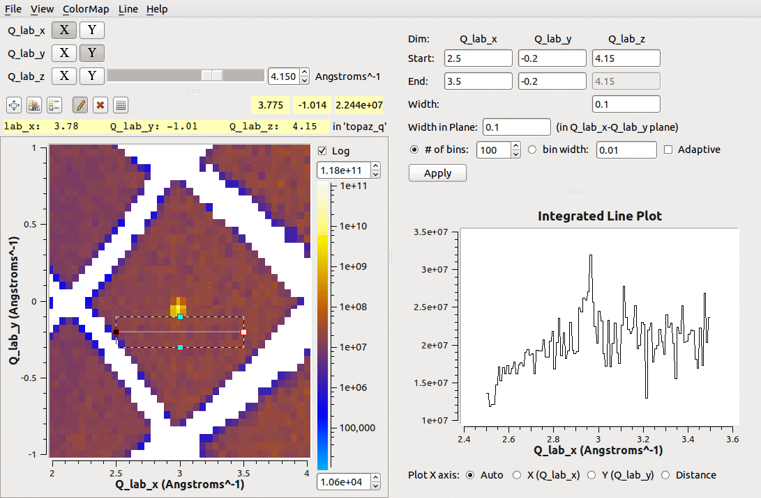
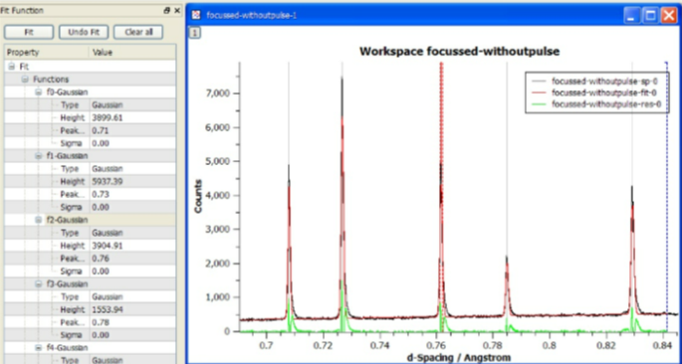
What we can do - Tools

Slide 10
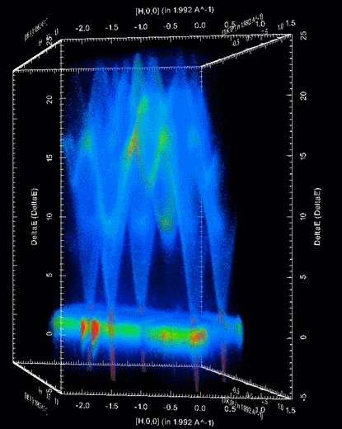
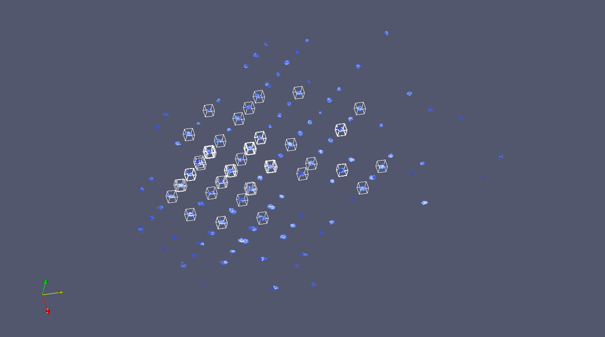
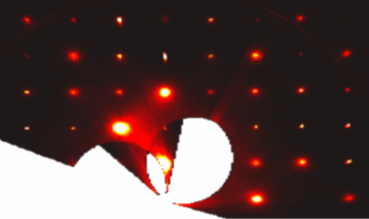
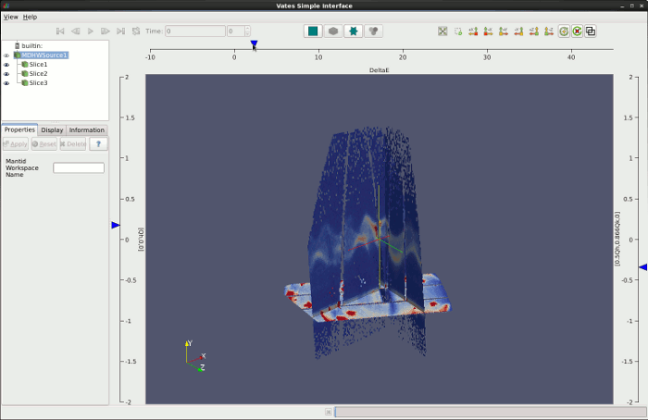
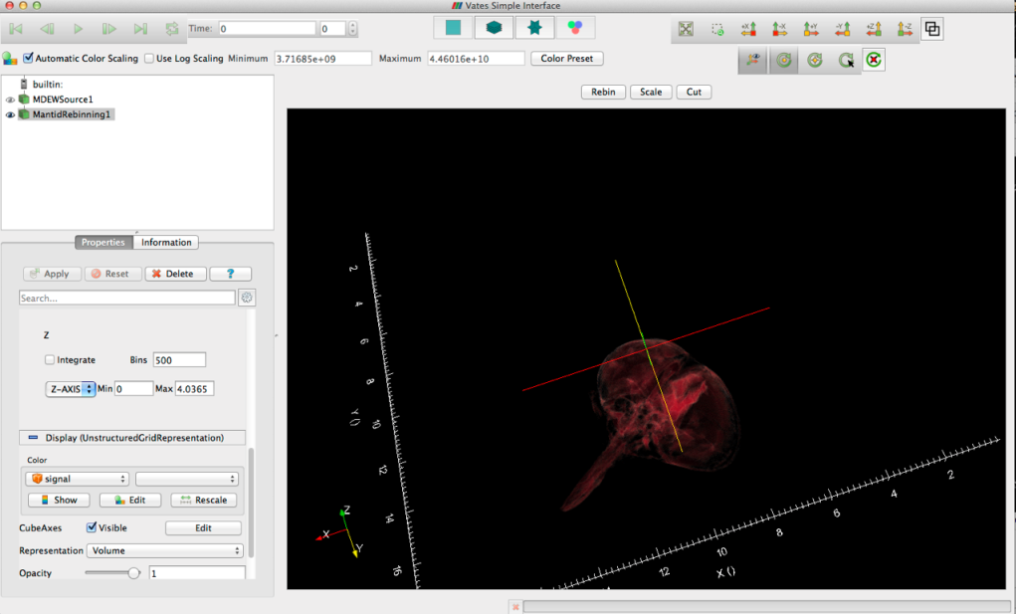
What can we do - Visualization

Slide 11
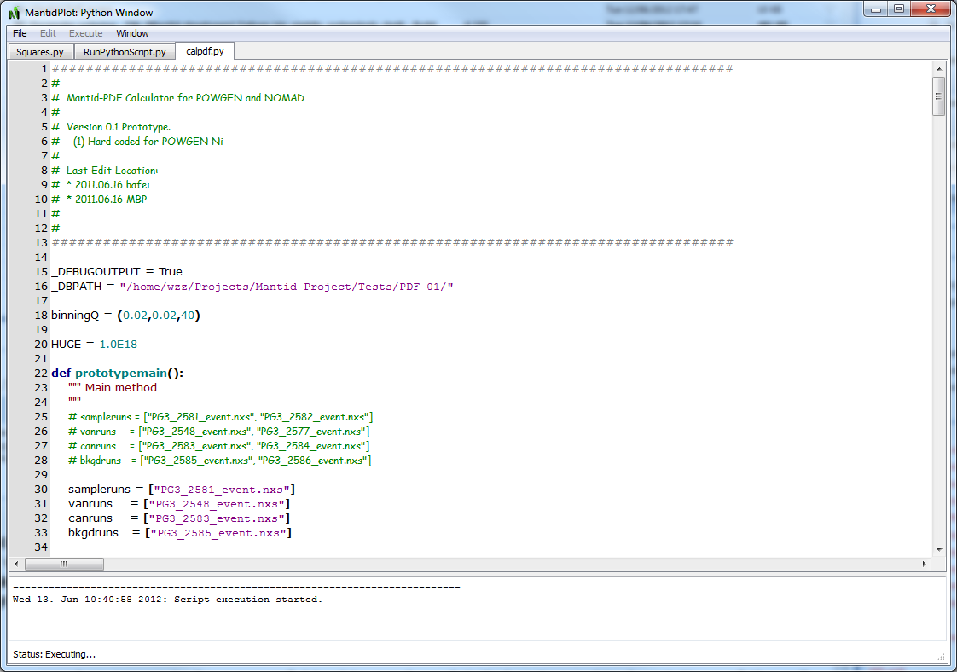
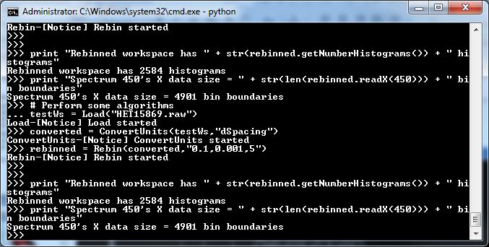
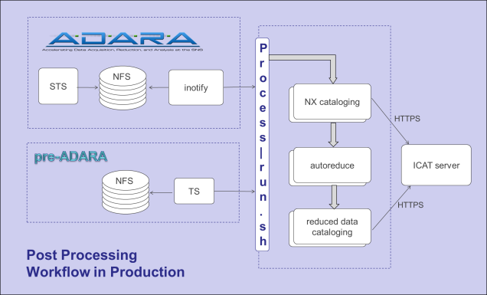
What we can do - Scripting
Python Control
Within MantidPlot or command line
iPython Shell
Integrated numPy
Python Plugins
Algorithms
Fitting functions
User interfaces
Automated reduction

Slide 12
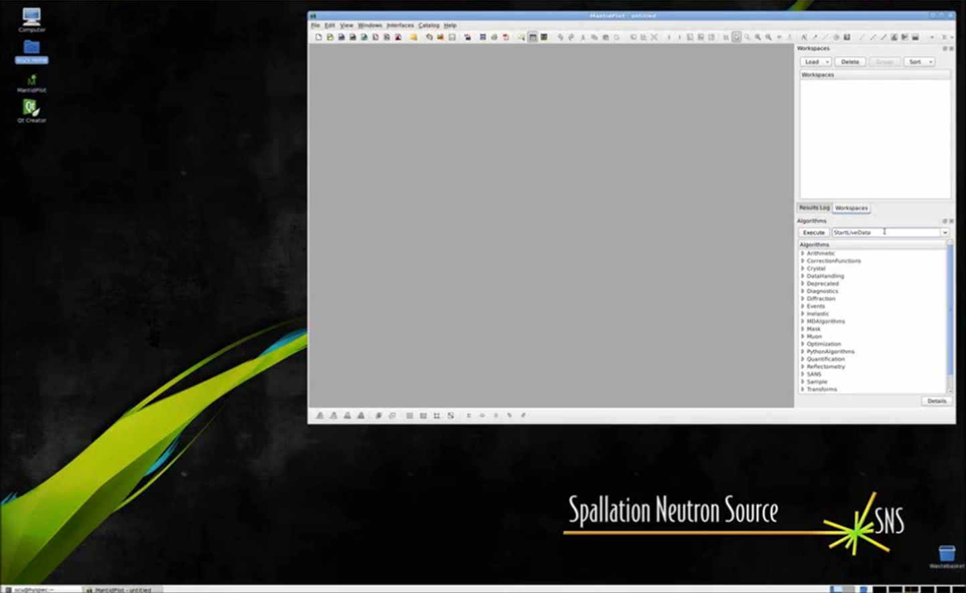
Live data reduction

Slide 13
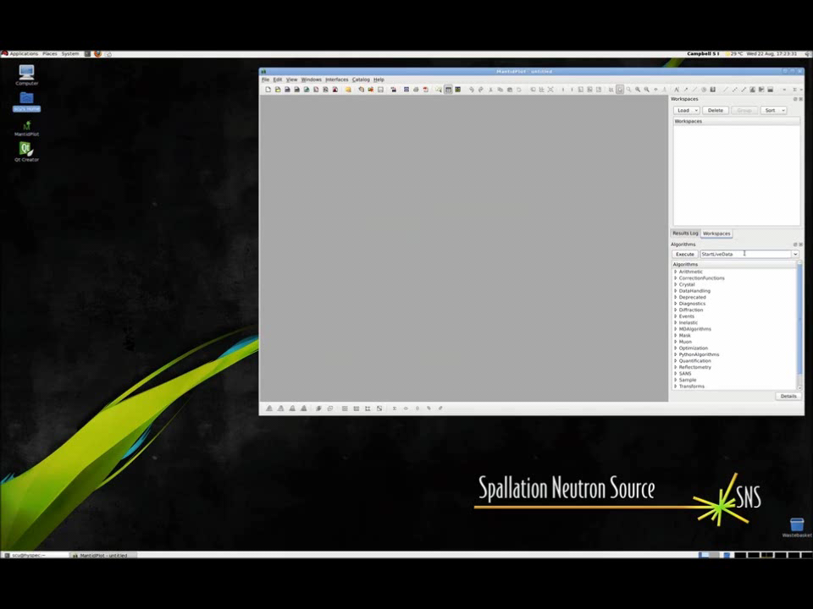
Live data reduction

Slide 14

Future Plans

Slide 15
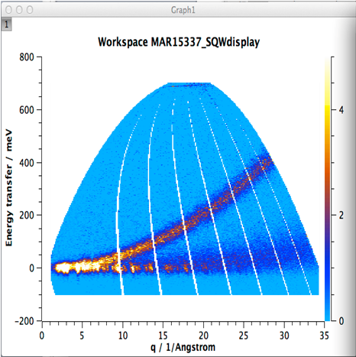
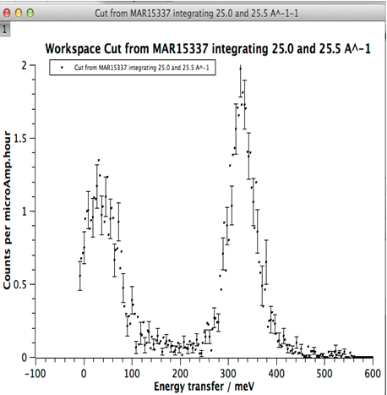
Intelligent Run Control
Define Region of interest
Define error bar criteria
BEGIN Run
Update from DAE & Reduce data to S(q,w)
Calculate statistic for ROI
Does statistic meet criteria
NO
YES
END run

Slide 16
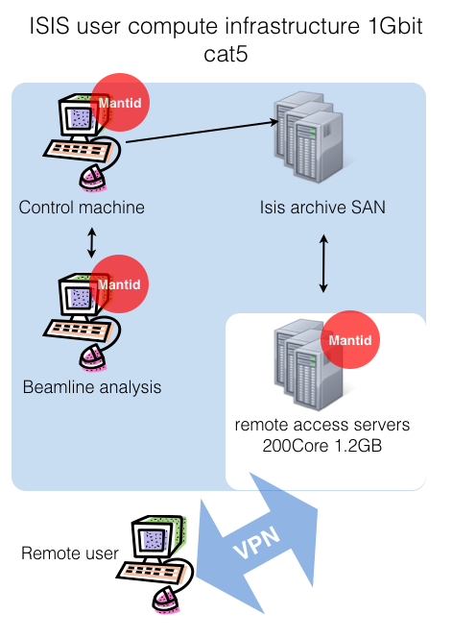
Current high Volume data
users need to:
Use SSH
Use VNC
Use VPN
federal ID and password
Also 3D views will not work well

Slide 17
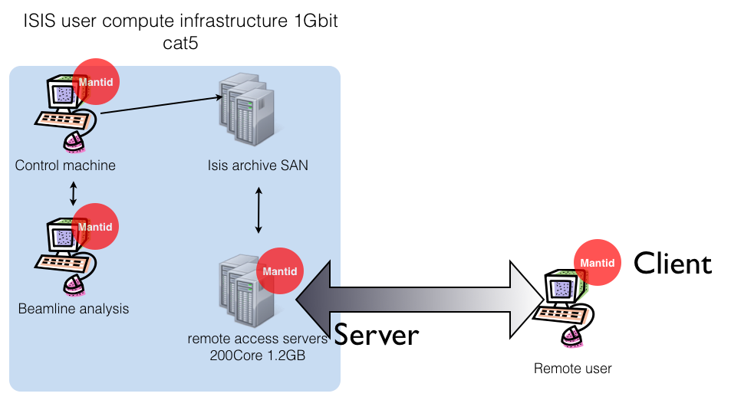
A possible solution

Slide 18
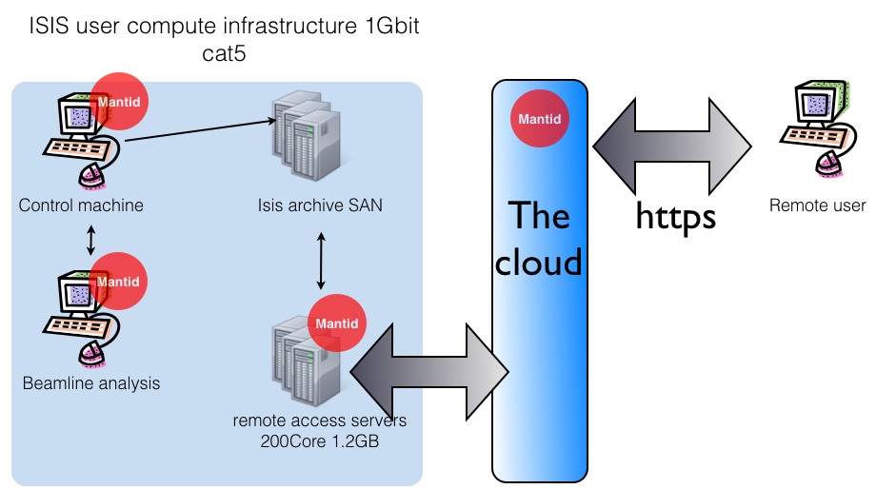
Web data access and reduction

Slide 19

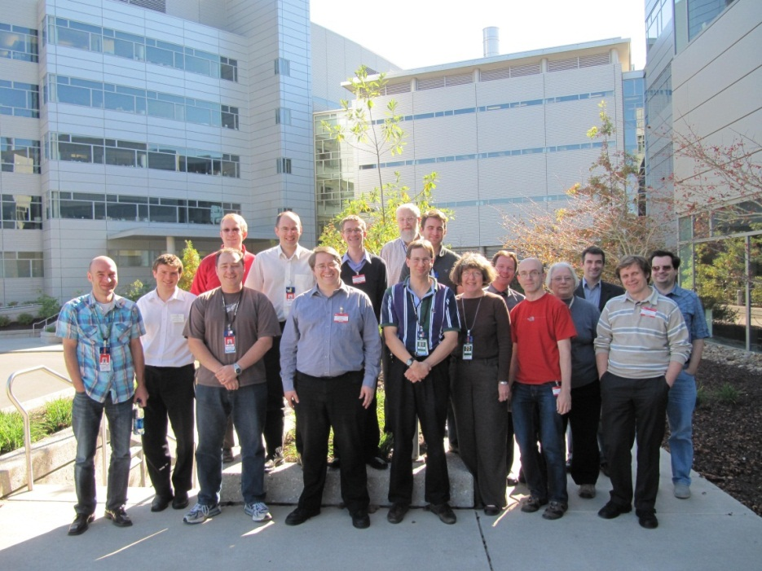

Further information
Project web page - www.mantidproject.org
VATES Poster - Poster Session B
Tessella - Stand 18
Many Thanks to the Project Sponsors
And the development team

